Slide 1

Alien invasion pyGame
Author: Anshita Saxena
Inspired from: “PYTHON CRASH COURSE” Book by Eric Matthes

Slide 2
Aliens: PyGame (Complete Game Explanation)
This Alien invasion game is based on eight categories:
Aliens
Bullets
Button
Game Statistics
Scoreboard
Ship
Settings
Main Alien Invasion Game File
Special Libraries/modules/functions used:
Pygame- Dedicated to create games in python.
Sprite- To work on grouped items (like aliens, bullets, ships)
Sys- To manage python program (closing the game- sys.exit())
Sleep- To pause a game
Build-in Methods used:
game.screen.get_rect()- Get the screen width and height
pygame.image.load()- Get the image loaded
self.screen.blitme()- Draw the loaded image
pygame.font.SysFont()- Style and size of text

Slide 3
Aliens: PyGame Continue (Complete Game Explanation)
self.font.render()- This function accepts four arguments: text, visible or not, text color, background color
self.object.draw()- This function is from Sprite to draw the image of object.
self.screen.fill()- This function accepts two arguments: color, object image
self.screen.blit()- This function accepts two arguments: text-image-font, text-image
pygame.mixer.init()- This function initialize sound in the game
pygame.display.set_mode((width, height), fullscreen)
pygame.display.set_caption()- This function sets the screen title.
pygame.sprite.Group()- This function initializes the group of related objects, i.e., bullets or aliens
self.object.empty()- The object will be empty once this function will be called
sleep(seconds)
pygame.mouse.set_visible(True)- The mouse will be visible if the argument is True otherwise False.
self.object.sprites()- Create the list of object.
pygame.sprite.spritecollideany(object1, object2)- To detect if there is a collision between two sprite objects.
pygame.sprite.groupcollide(object1, object2, True, True)- To detect the group collision between two objects. First ‘True’ is for one object1 collide with only one object2 otherwise ‘False’. Second ‘True’ is for object2 with similar first ‘True’ explanation.
self.play_button.rect.collidepoint(mouse_pos)- To check whether mouse is clicked on the image or not.
pygame.K_SPACE- This attribute detects whether space is entered or not.
pygame.display.flip()- Make the recent created screen visible.

Slide 4
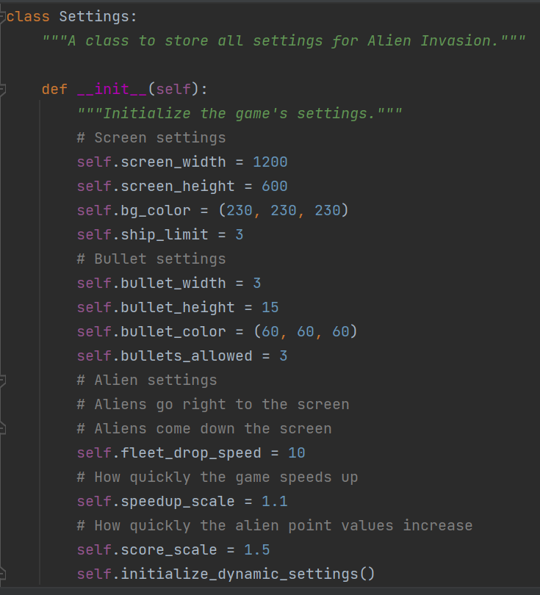
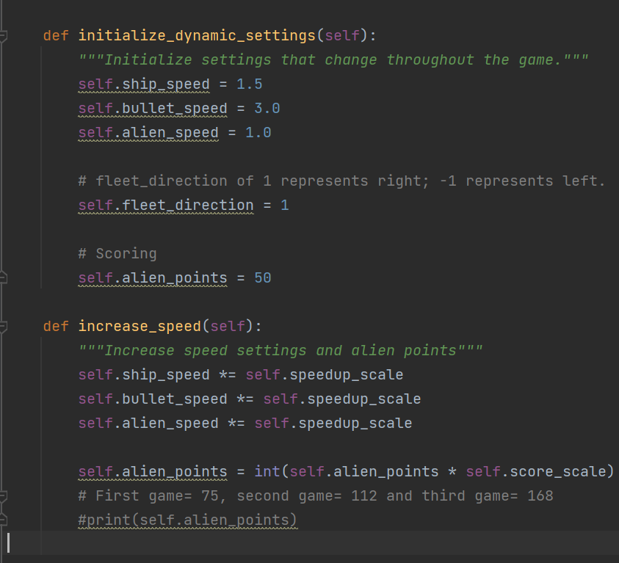
Aliens: PyGame Continue (Complete Game Explanation)
Settings module is for setting the default properties for objects such as Screen, ship, bullets and aliens. This module involves speed of objects and scale up of speed when the game levelled up.

Slide 5
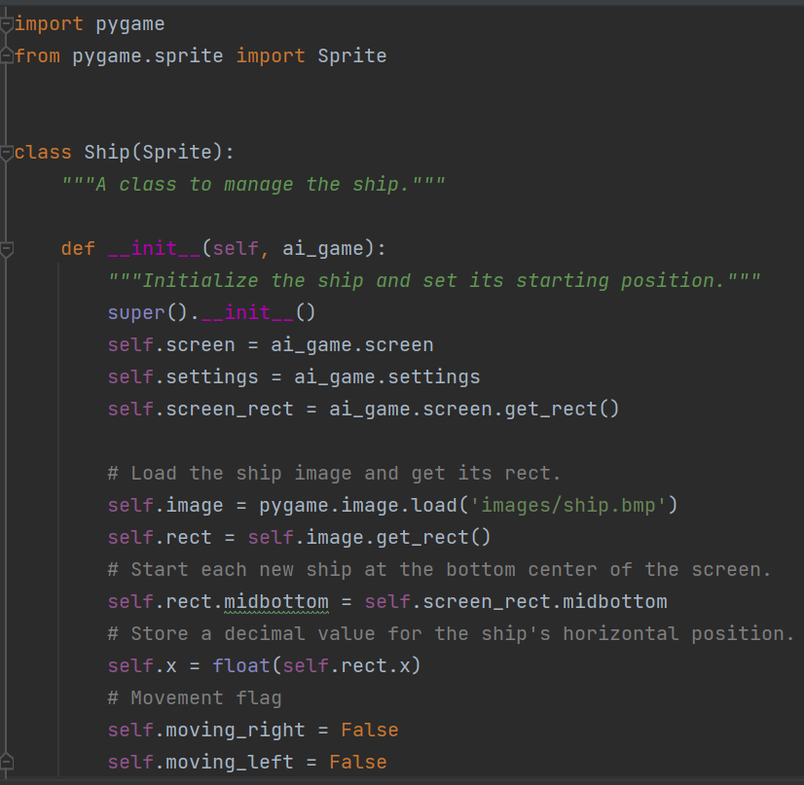
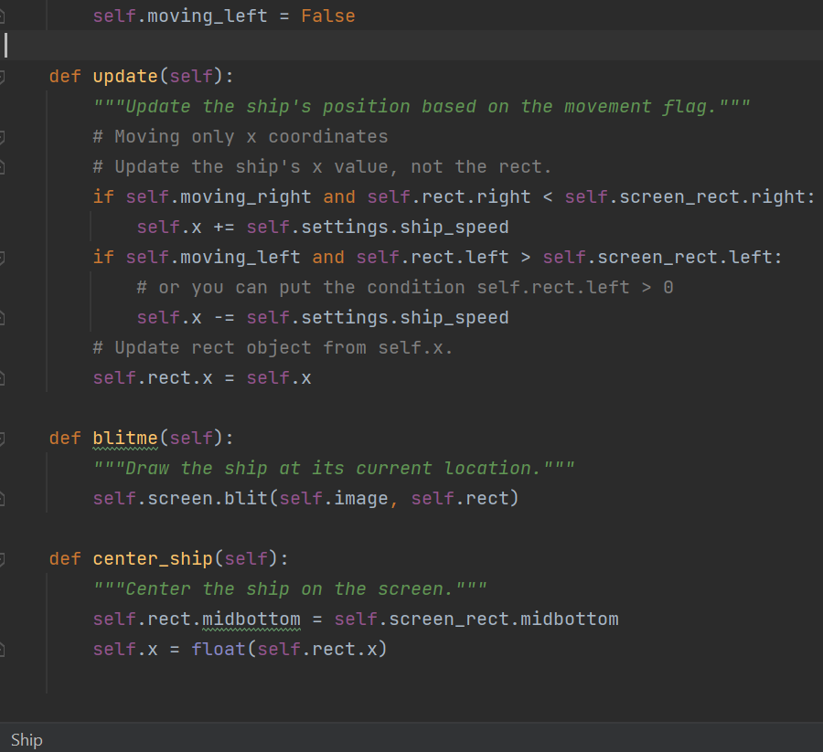
Aliens: PyGame Continue (Complete Game Explanation)
Ship module uses Sprite class for creating a group of ships in the scoreboard. Ship class sets the properties of the ship image. It also has the update for moving ship left to right, blitme for creating a ship image at the bottom of the screen, and center_ship for placing the ship in the center of the screen.

Slide 6
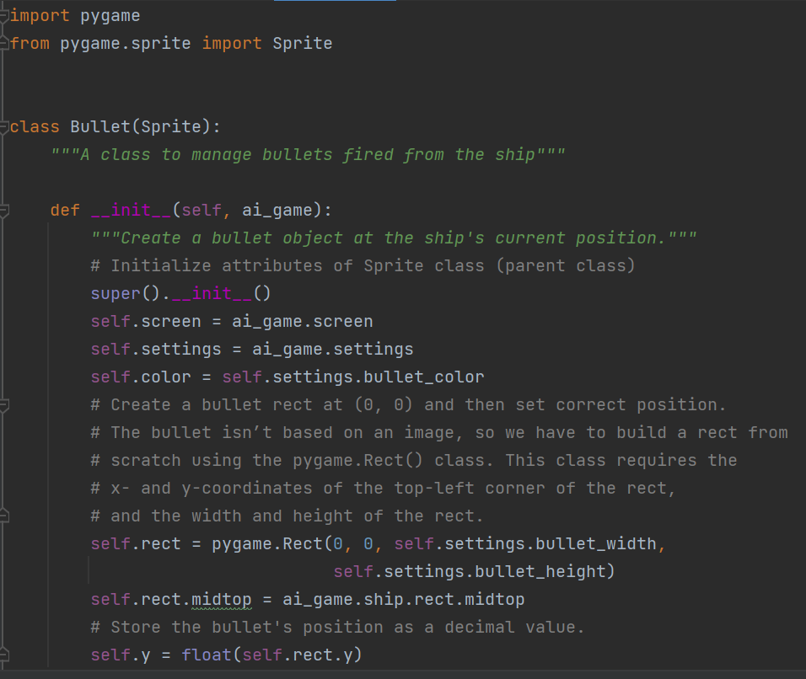
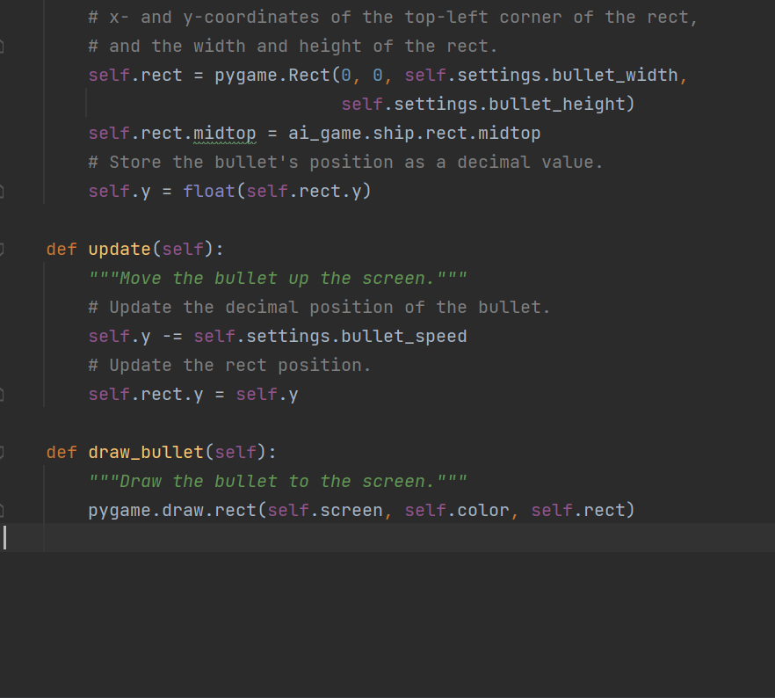
Aliens: PyGame Continue (Complete Game Explanation)
Bullet module uses Sprite class for creating a group of bullets while shooting aliens. Bullet class sets the properties of the bullet image. It also has the update for moving the bullet vertically, and draw_bullet for drawing the bullets.

Slide 7
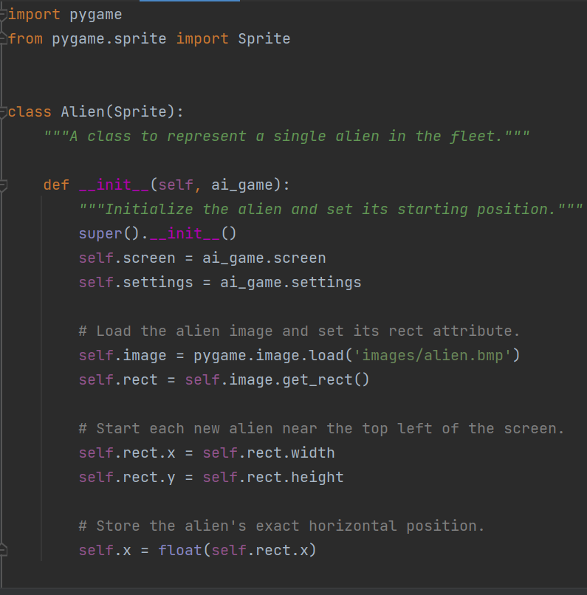
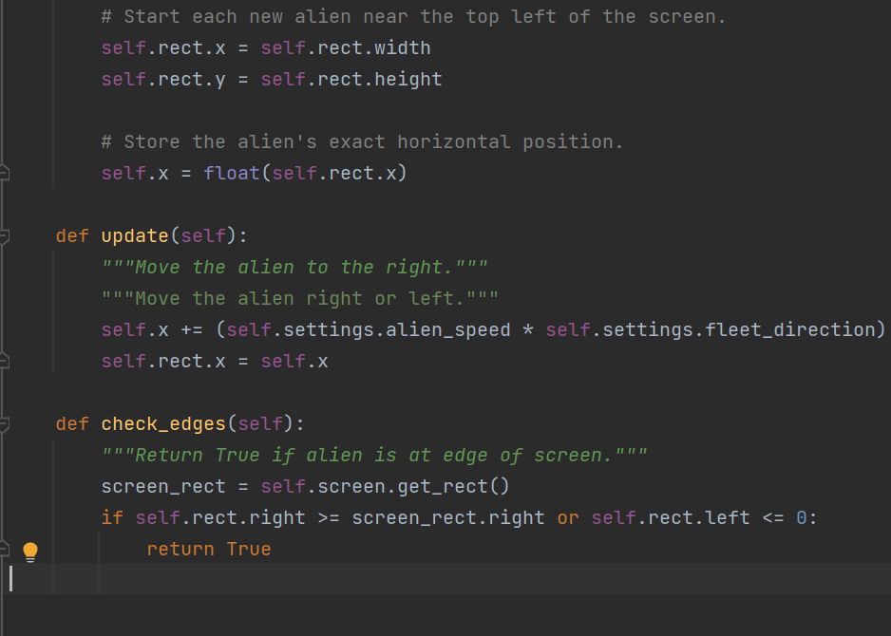
Aliens: PyGame Continue (Complete Game Explanation)
Alien module uses Sprite class for creating a group of aliens. Alien class sets the properties of the bullet image. It also has the update for moving the alien left-right horizontally and check_edges for helping aliens to not disappear from screen.

Slide 8
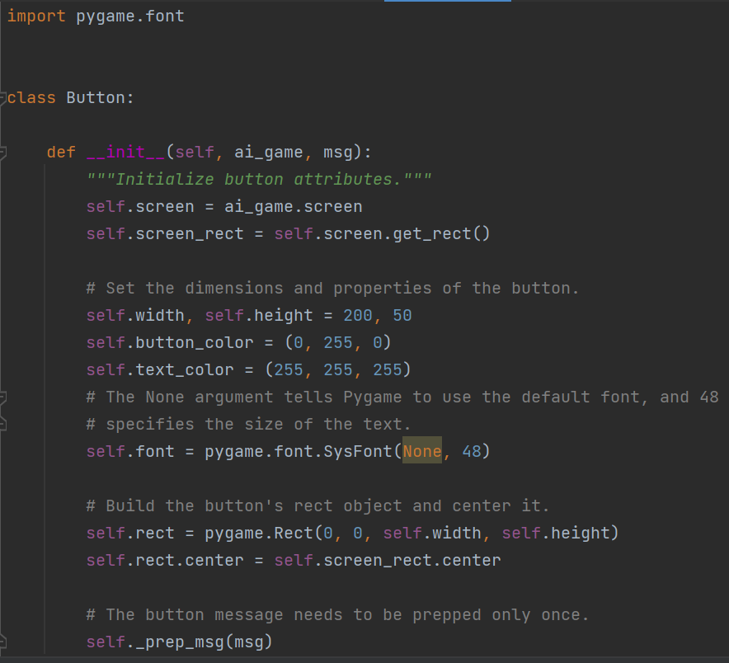
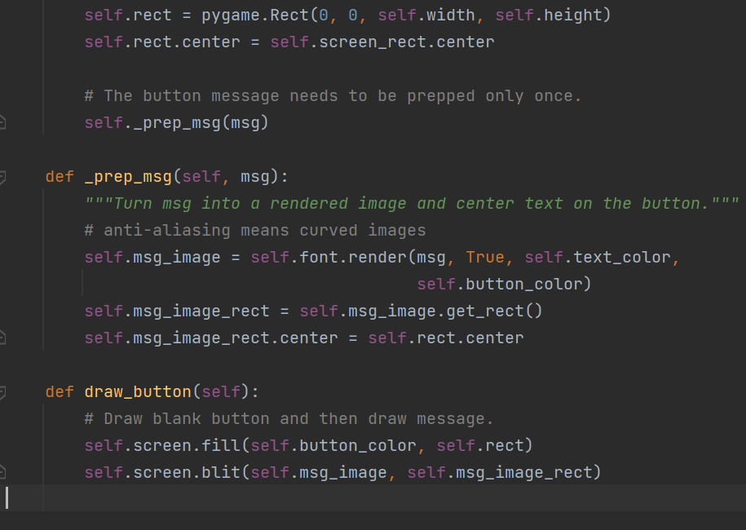
Aliens: PyGame Continue (Complete Game Explanation)
Button module is for creating a Play button. Button class sets the properties of the Button image. It also has the _prep_msg helper function which keeps the button in the center of the screen and draw_button function for keeping and helping the button to appear on screen.

Slide 9
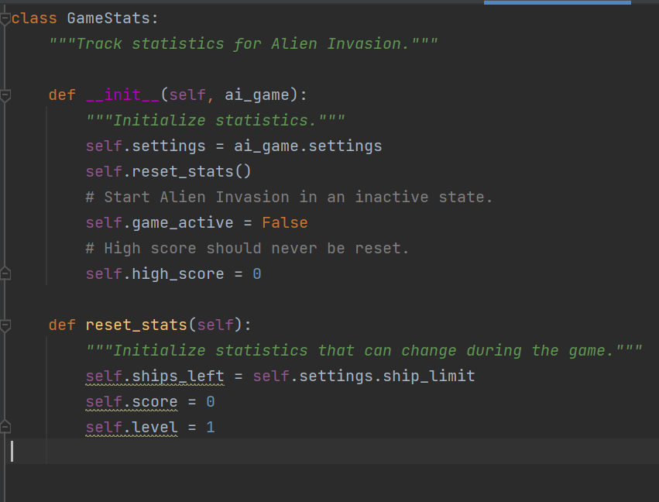
Aliens: PyGame Continue (Complete Game Explanation)
GameStats module is for setting the statistics for the game which involves game is active or not, game’s high score, number of ships left, and level of game.

Slide 10
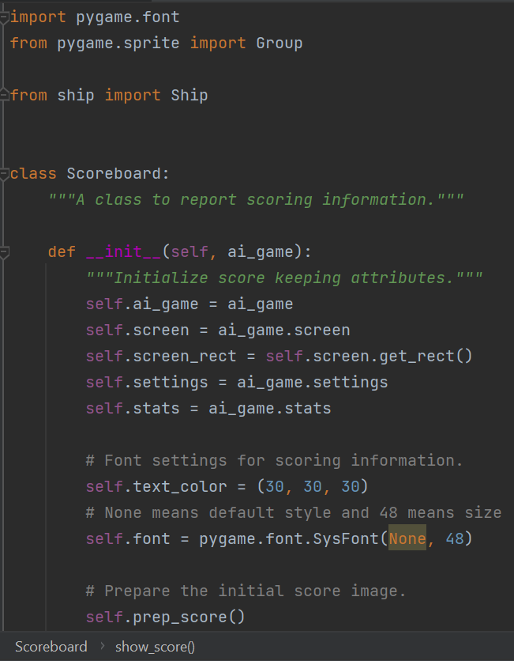
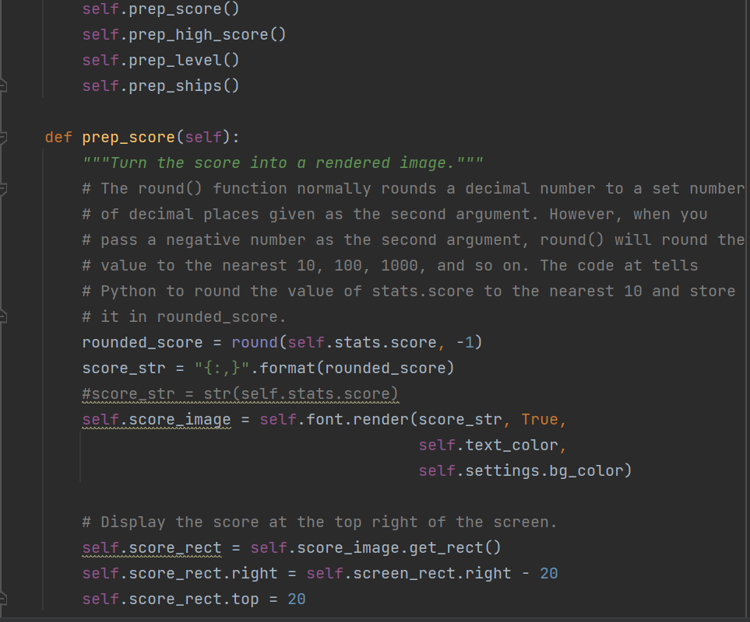
Aliens: PyGame Continue (Complete Game Explanation)
Scoreboard module is for setting the game’s scoreboard which involves game’s current score, game’s high score, game’s level, and ships left to play. Init method sets the default properties for font and calls the helper functions.
Prep_score shows the current score of the play at right side of the screen, prep_high_score shows the high score in the center of the screen, prep_level shows the level at the right side of the screen, prep_ship shows the group of ships left to play the game at the left side of the screen, show_score draws the current score high score, levels and ship group on the screen, and check_high_score helps to the highest score within all the games scored.

Slide 11
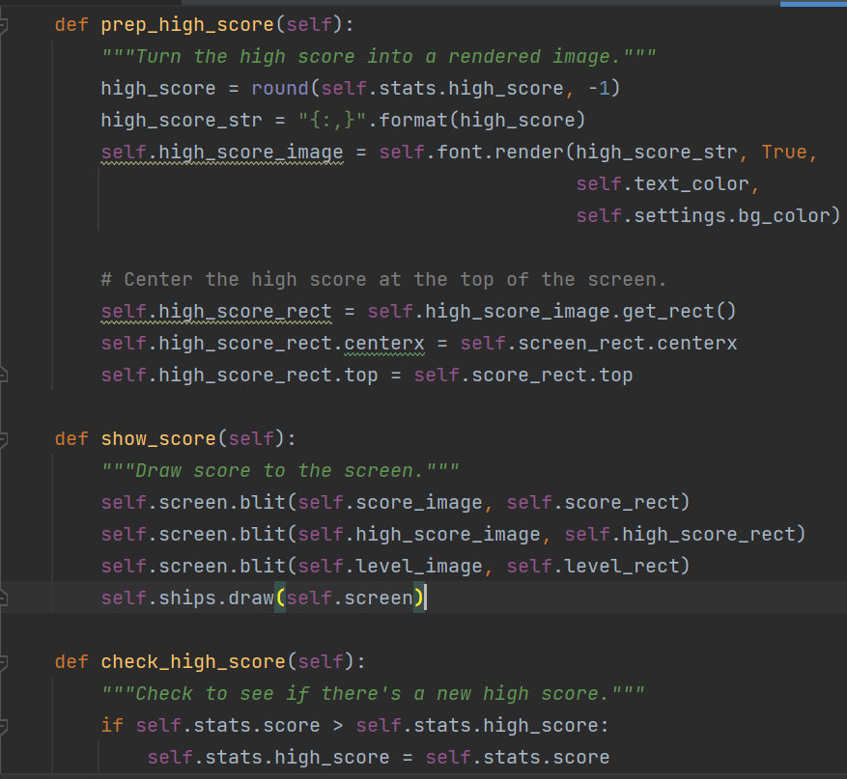
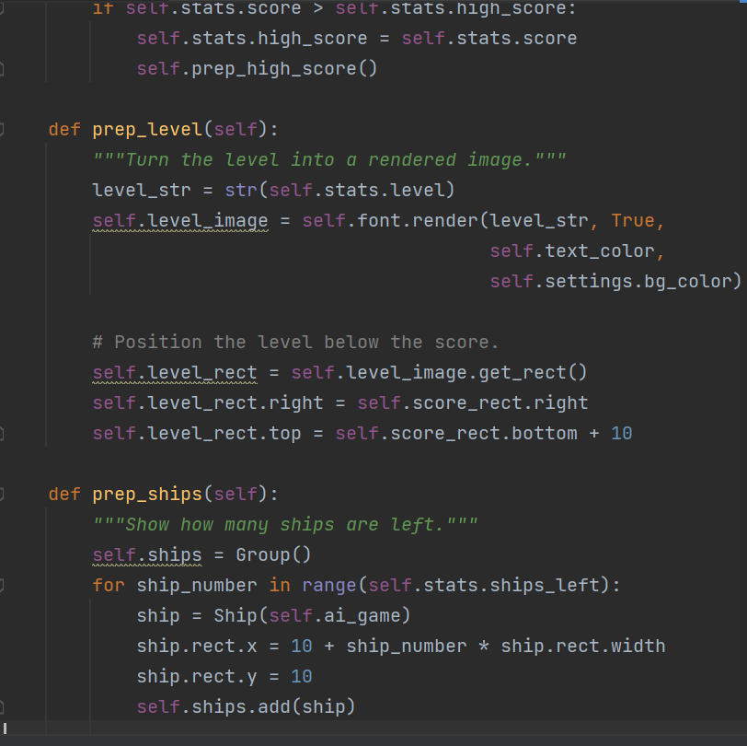
Aliens: PyGame Continue (Complete Game Explanation)

Slide 12
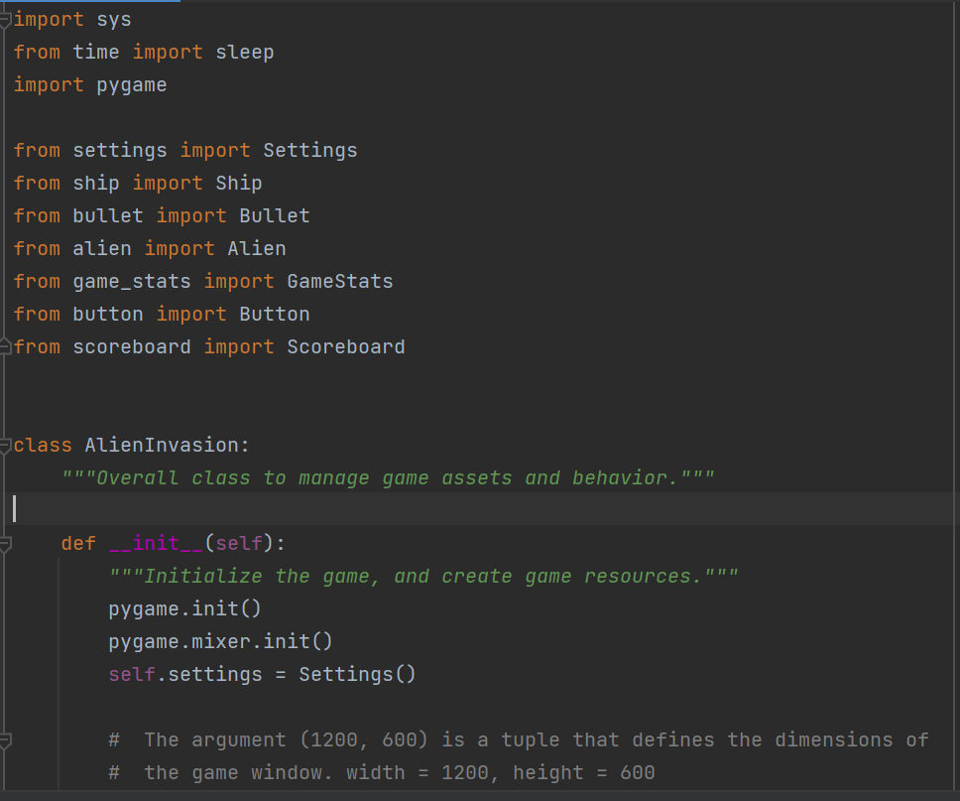
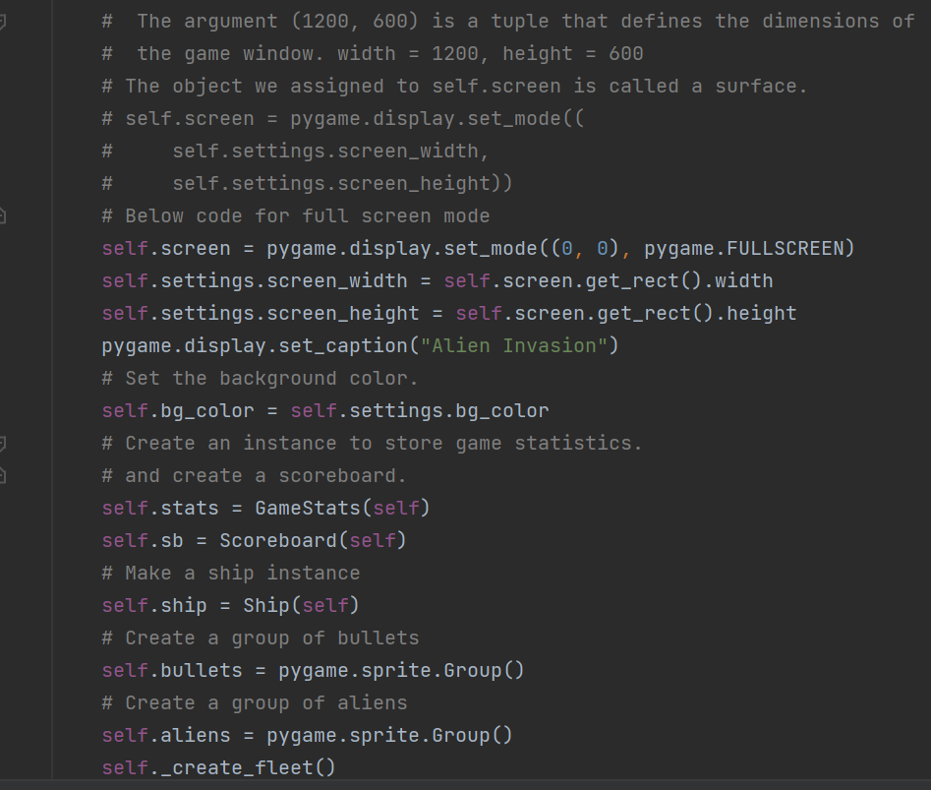
Aliens: PyGame Continue (Complete Game Explanation)
Alien_invasion_settings module is for creating the main game.
Init method initializes the screen’s settings, gamestats, scoreboard, ship, bullet group, aliens fleet, and play button. This method calls a helper function ‘_create_fleet()’. This helper function is responsible for creating the group of aliens in a way that they can occupy space horizontally and vertically by leaving some space for ship so that ship can attack aliens by bullets correctly.

Slide 13
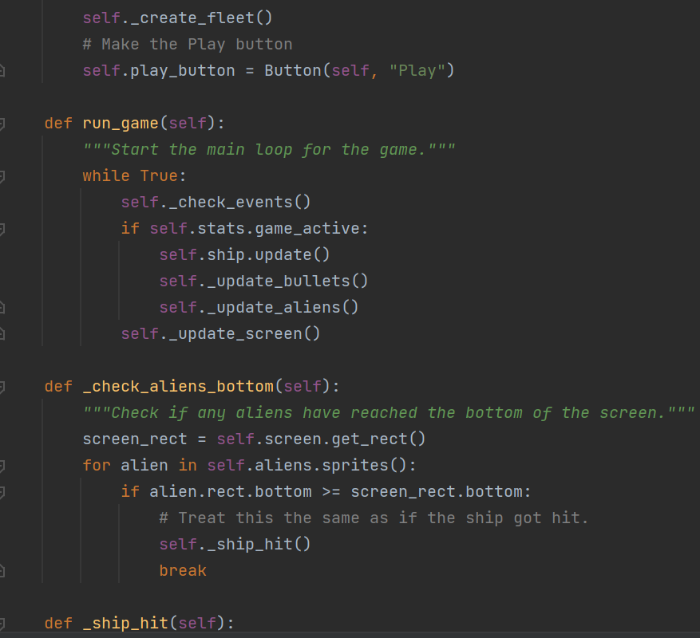
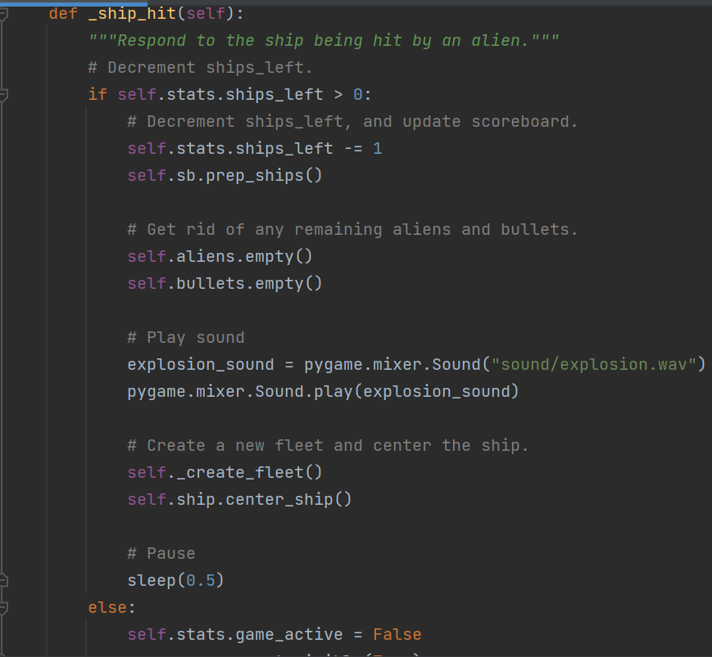
Aliens: PyGame Continue (Complete Game Explanation)
run_game is the main method which is called by main function in the starting of this game (application). In this method, ‘while True’ is responsible for holding the screen. If this while loop will be removed then the screen will disappear in one second. This methods calls several other helper functions.
_check_aliens_bottom() checks the aliens hits the ship or not. If alien hit the ship then the number of ships will be decremented by one, aliens and bullets list will be empty, a sound will be played and then it creates a new fleet of aliens, keeps the decremented ship in the center and pause the game for 0.5 seconds.

Slide 14
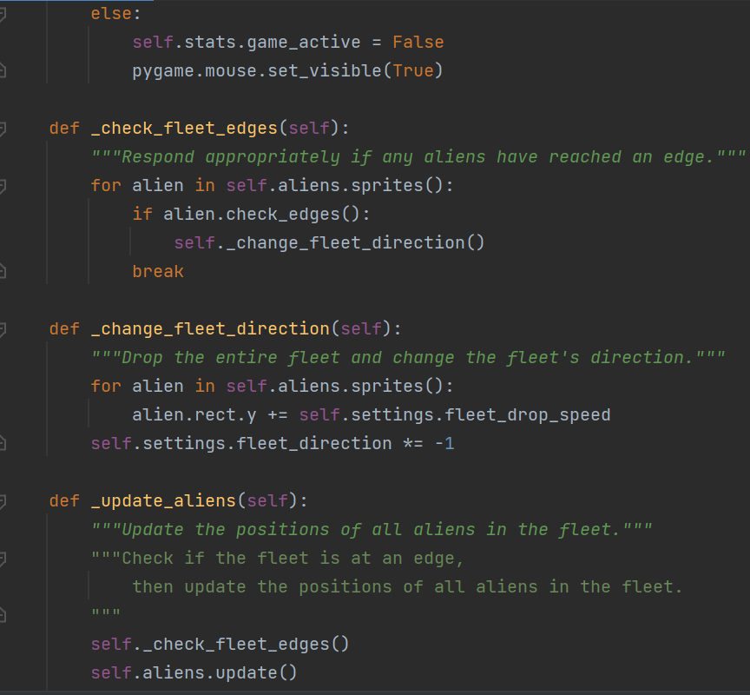
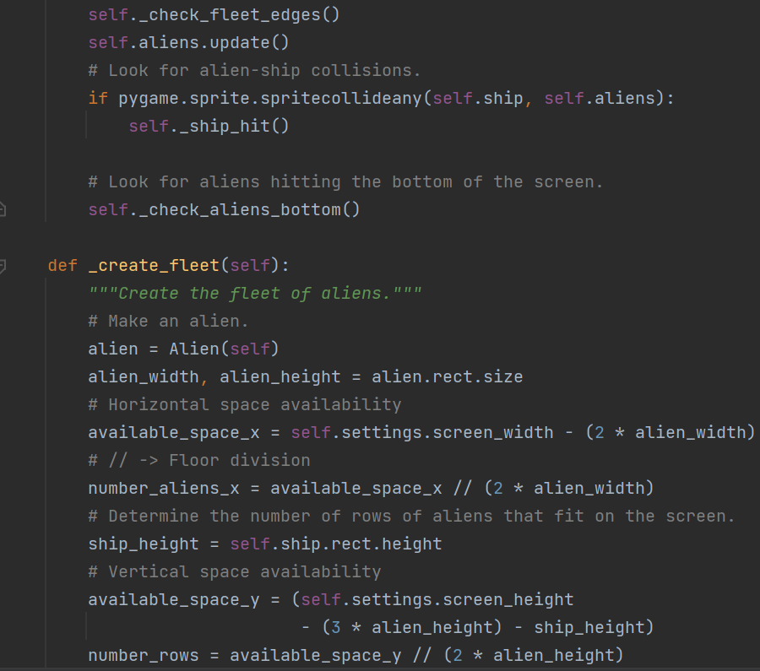
Aliens: PyGame Continue (Complete Game Explanation)
If no ship will be left then game will go in inactive state and mouse will become invisible.
_check_fleet_edges() checks whether the aliens hit the edges or not. If aliens hit the edge right or left then aliens group will turn to left or right respectively [_check_fleet_direction()].
_update_aliens() check if aliens hit/collide with ship, if it collides, then it will call the _ship_hit(). It also calls _check_aliens_bottom() to check whether aliens hit the bottom or not.
_create_fleet() is described in slide 97.

Slide 15
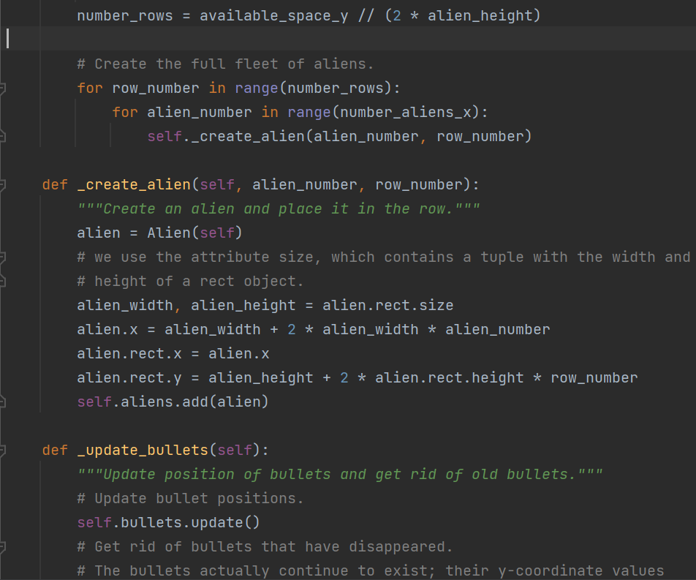
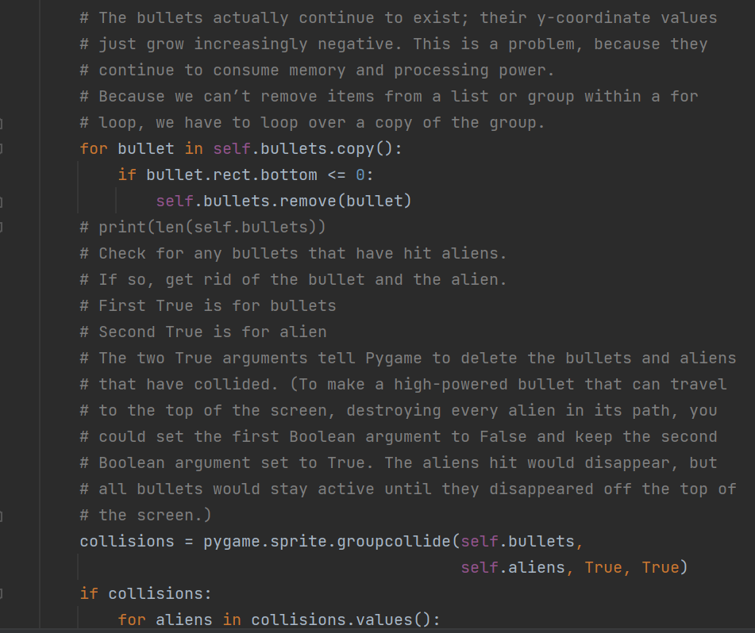
Aliens: PyGame Continue (Complete Game Explanation)
_update_bullets() checks whether the list of bullets is passed the top edge or not, if bullets pass, then remove those bullets from the list. It also checks whether bullets collide with aliens or not.

Slide 16
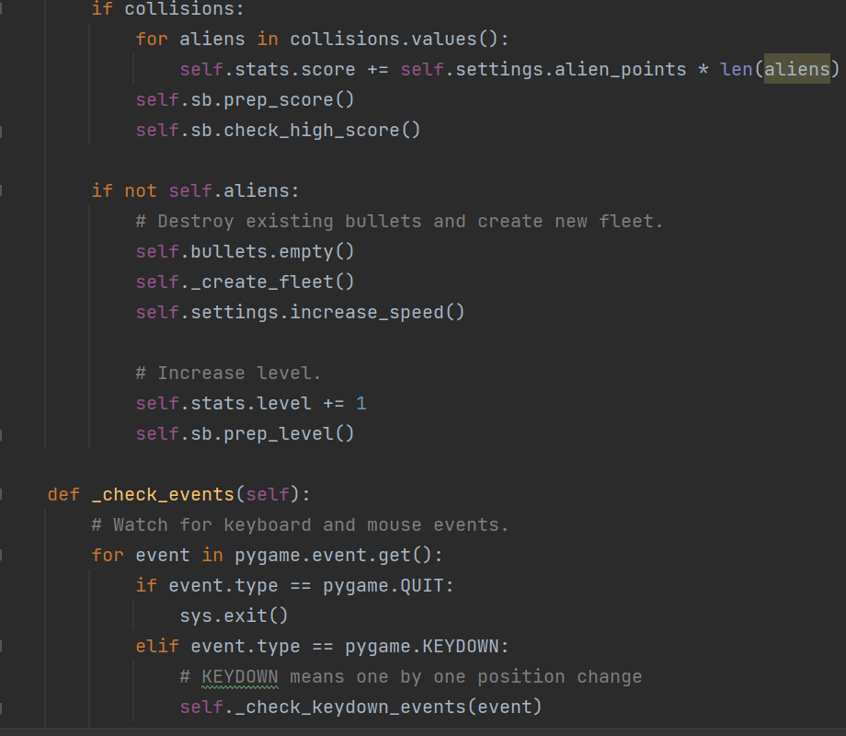
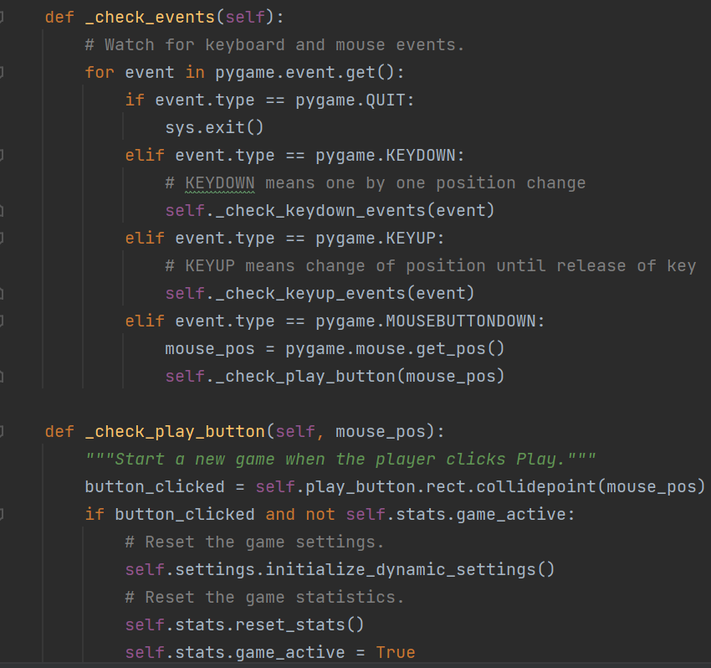
Aliens: PyGame Continue (Complete Game Explanation)
If bullet collide with aliens then increase the current score with the help of pre_score() and update the high score with the help of prep_high_score() if required. If there is no aliens under this functionality means all the aliens got shot down by the bullets, means need to build a new fleet, increase the speed of the game, and increase the level of the game.
_check_events() checks which key is pressed. ‘Q’ key quits the game. KEYDOWN is for moving left or right with one step at a time. KEYUP is for stopping the position of object when the key is released. MOUSEBUTTON is for ‘Play’ button.

Slide 17
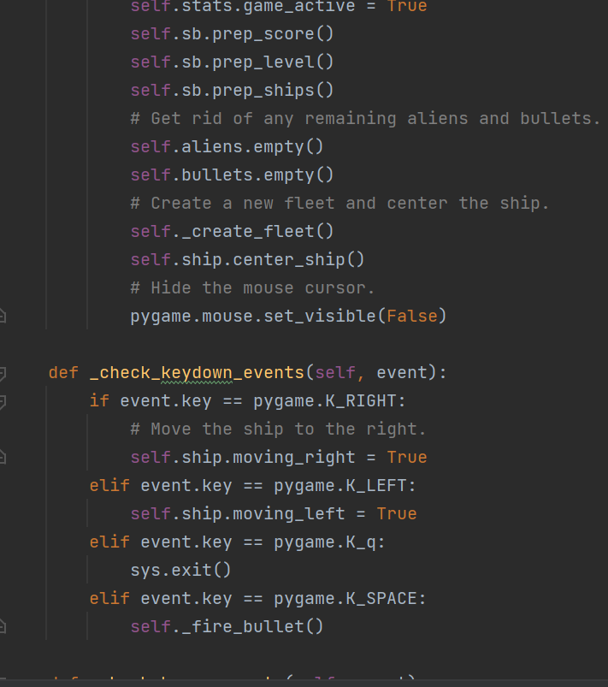
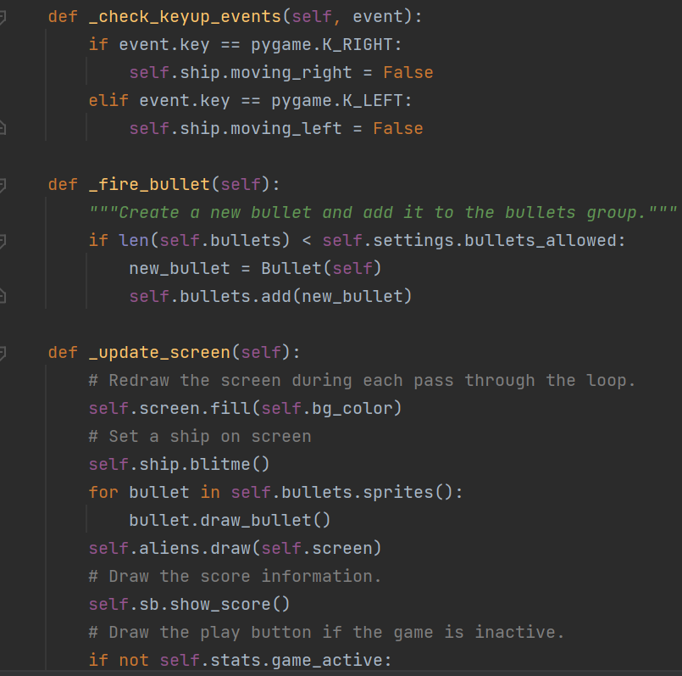
Aliens: PyGame Continue (Complete Game Explanation)
If game is inactive then ‘Play’ button appears with mouse otherwise mouse will not appear on the screen. If button will be clicked then the game will be reset (this is designed for the player when it reaches to the next level).
_check_keydown_events() and _check_keyup_events() are self explanatory methods.
_fire_bullet() is for creating a bullet and add it to the bullet sprite group.
_update_screen() is the main function to display ship, bullets, aliens, scores and if game is in inactive state then ‘play’ mouse button.

Slide 18
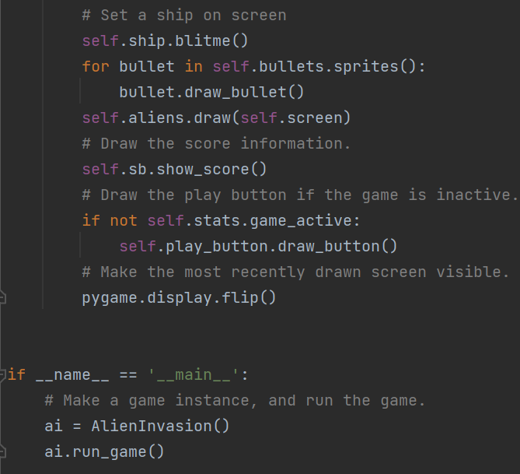
Aliens: PyGame Continue (Complete Game Explanation)
Lastly, main function is their, whether the classes’ object is instantiated and run_game() will be called for running this game (application).

Slide 19

THANK YOU

